Slide 1
MINISTRY OF EDUCATION KADUNA STATE RADIO TELEVISION PROGRAMME E-LEARNING
SUBJECT: MATHEMATICS
TOPIC -STATISTICS

Slide 2
What is Statistics
Statistics could be defined as the collection, organization, analyses, interpretation and presentation of data. Statistics is divided into two branches, they are:
Descriptive Statistics
Inferential Statistics
We are going to learn about descriptive statistics which include the:
Measures of central tendency
Measures of dispersion
The measures of central tendency are (a) mean (b) median and
(c) mode

Slide 3
What is Statistics (Cont)
Mean: Mean is the sum of a given set of numbers divided by the number of items. It is also known as the average.
Median: Median is the middle term in any given set of numbers after arranging them in order of size i.e. from ascending or descending order. In case the number of occurrence is even, the median is the average of the two middle numbers.
Mode: Mode is the number with the highest frequency. That is, the number which occur most.

Slide 4
Example 1
Calculate the:
Mean
Median and
Mode
of each of the following set of numbers
3, 2, 1, 3, 4, 5, 3
5, 10, 8, 7, 12, 12

Slide 5

Solution
Number 1: 1, 2, 3, 3, 3, 4, 5
(a) mean ($x$) = sum of numbers
number of items
= 1 + 2 + 3 + 3 + 3 + 4 + 5
7
= 21
7
= 3

Slide 6
(b) median = 4th term
= 3
(c) mode = 3 (number of with highest frequency)

Slide 7

Solution
Number 2: 5, 7, 8, 10, 12, 12
(a) mean ($x$) = sum of numbers
number of items
= 5 + 7 + 8 + 10 + 12 + 12
6
= 54
6
= 9

Slide 8
Solution (Number 2 cont)
(b) median = sum of two middle numbers
2
= 8 + 10
2
= 18
2
= 9
(c) mode = 12 (occur most)

Slide 9
Example 2
The table below gives the distribution of marks obtained by number of students in a mathematic test.
Calculate the:
Mean
Median and
Mode of the distribution
Marks ($x$) | 3 | 4 | 5 | 6 | 7
Frequency (f) | 2 | 1 | 4 | 2 | 1

Slide 10
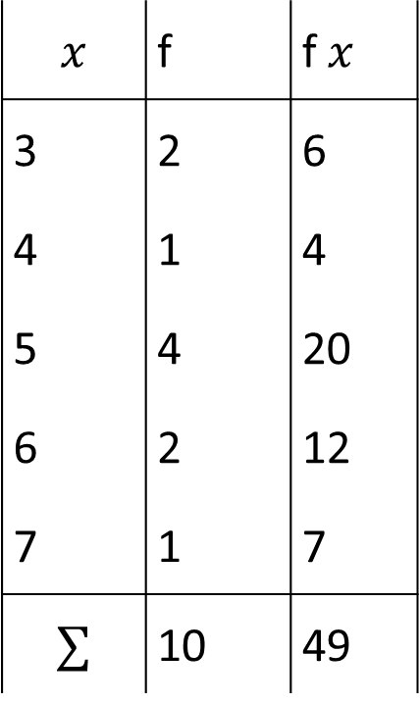
Solution
$$x$$ | f | f$x$
3 | 2 | 6
4 | 1 | 4
5 | 4 | 20
6 | 2 | 12
7 | 1 | 7
$$∑$$ | 10 | 49

Slide 11

(a) Mean ($x$) = $\frac{∑fx}{∑f}$
= $\frac{49}{10}$
= 4.9

Slide 12
(b) Median = 5th + 6th
2
= 5 + 5
2
= 10
2
= 5
(c) Mode = 5 (number with highest frequency)

Slide 13
Example 3
The table below shows the marks scored by a group of 32 students in a Further Mathematics test
Find the
i. Mean ii. Median
iii. Mode of the marks
b) Percentage of students who scored at-least 8 marks
Marks ($x$) | 1 | 2 | 3 | 4 | 5 | 6 | 7 | 8 | 9 | 10
Frequency (f) | 2 | 3 | 4 | 4 | 4 | 4 | 5 | 3 | 2 | 1

Slide 14
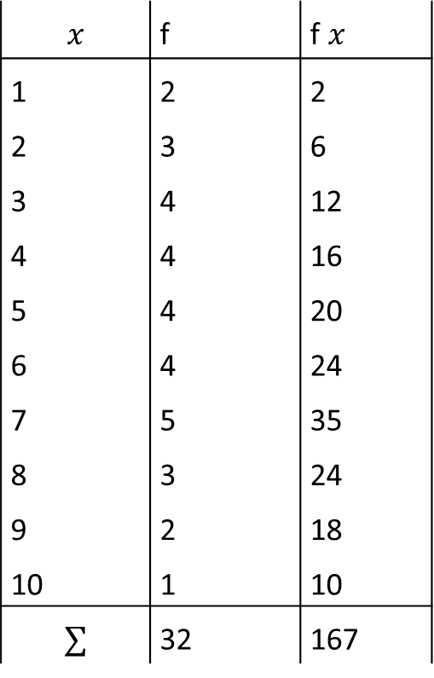
Solution
$$x$$ | f | f$x$
1 | 2 | 2
2 | 3 | 6
3 | 4 | 12
4 | 4 | 16
5 | 4 | 20
6 | 4 | 24
7 | 5 | 35
8 | 3 | 24
9 | 2 | 18
10 | 1 | 10
$$∑$$ | 32 | 167

Slide 15
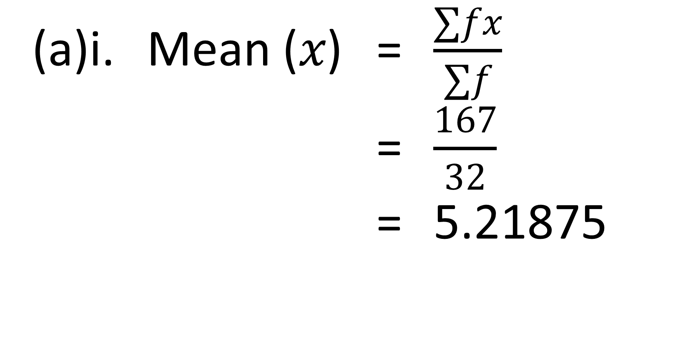
(a)i. Mean ($x$) = $\frac{∑fx}{∑f}$
= $\frac{167}{32}$
= 5.21875

Slide 16
ii. Median = 16th + 17th
2
= 5 + 5
2
= 10
2
= 5
iii. Mode = 7 (number with highest frequency)

Slide 17
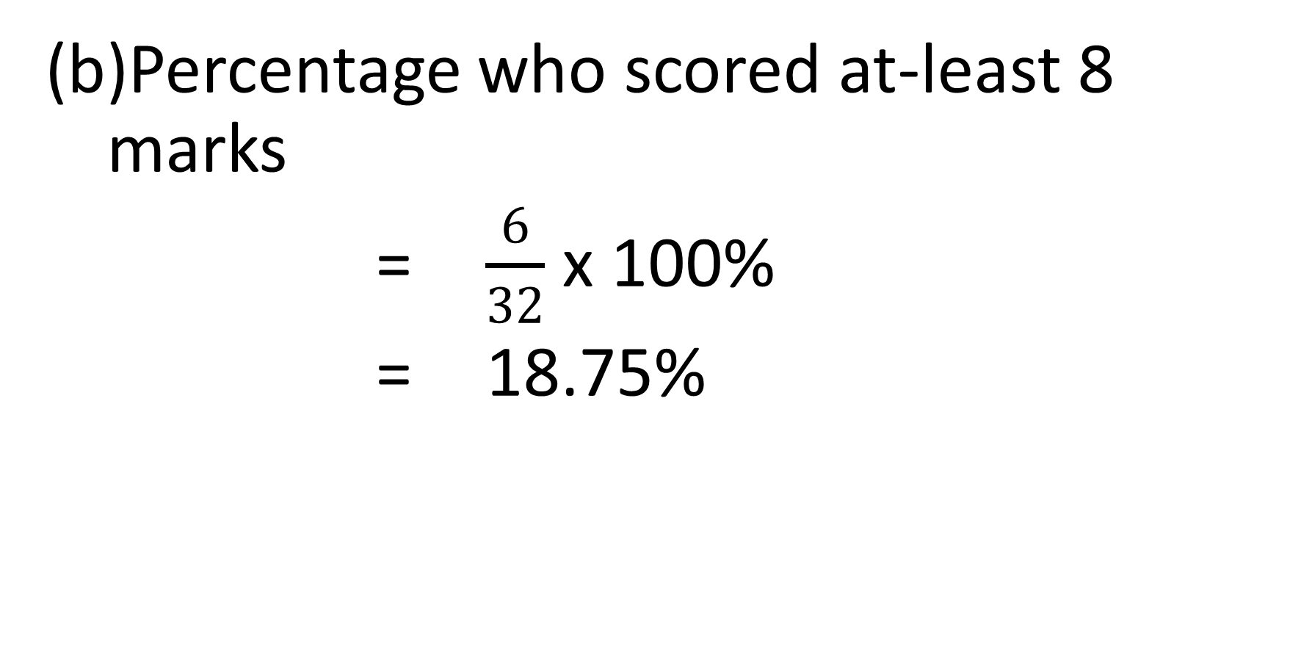
Percentage who scored at-least 8 marks
= $\frac{6}{32}$ x 100%
= 18.75%

Slide 18
Example 4
The table below shows the scores of a group of students in a test. If the mean score is 3.5. Find the:
Value of x
mode
Median
Scores ($x$) | 1 | 2 | 3 | 4 | 5 | 6
No. of students (f) | 1 | 4 | 5 | 6 | $$x$$ | 2

Slide 19
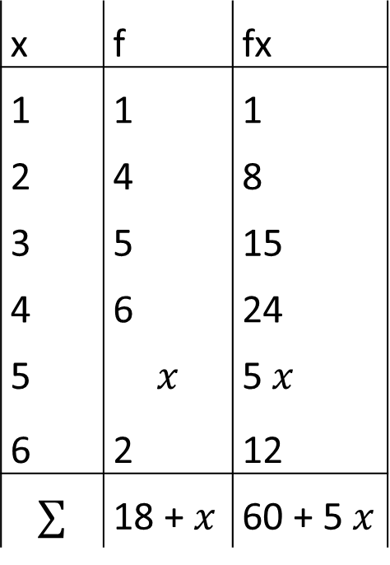
Solution
x | f | fx
1 | 1 | 1
2 | 4 | 8
3 | 5 | 15
4 | 6 | 24
5 | $$x$$ | 5$x$
6 | 2 | 12
$$∑$$ | 18 + $x$ | 60 + 5$x$

Slide 20
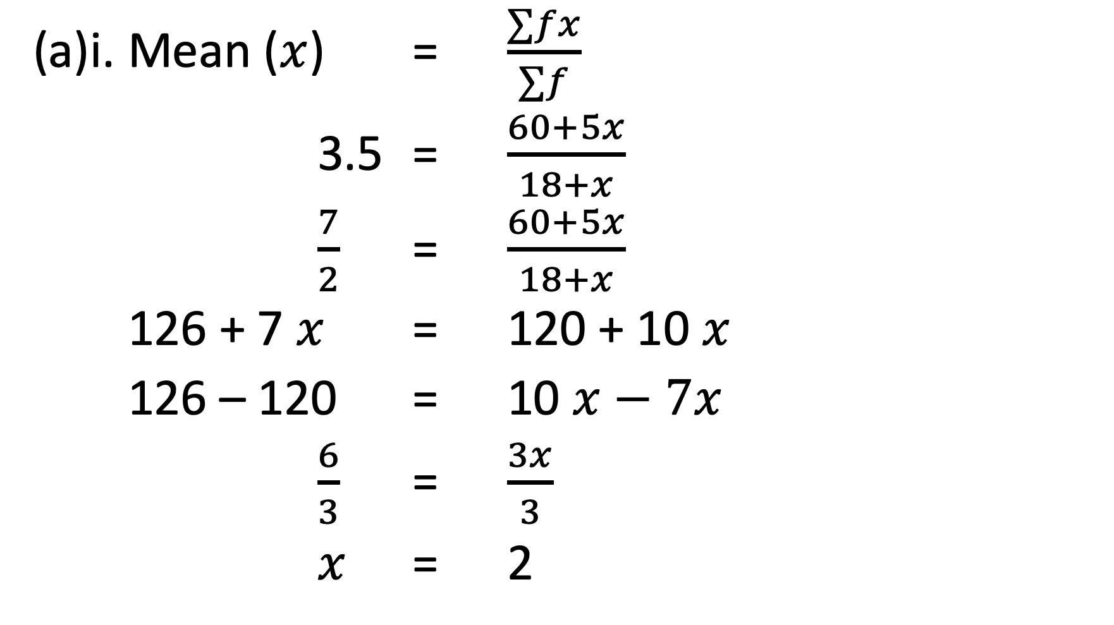
(a)i. Mean ($x$) = $\frac{∑fx}{∑f}$
3.5 = $\frac{60+5x}{18+x}$
$\frac{7}{2}$ = $\frac{60+5x}{18+x}$
126 + 7$x$ = 120 + 10$x$
126 – 120 = 10$x−7x$
$\frac{6}{3}$ = $\frac{3x}{3}$
$x$ = 2

Slide 21
The table now becomes
ii. Mode = 4 (Occur most)
(c) Median = 10th + 11th
2
= 3 + 4
2
= 7
2
= 3.5
Scores ($x$) | 1 | 2 | 3 | 4 | 5 | 6
No. of students (f) | 1 | 4 | 5 | 6 | $$2$$ | 2

Slide 22
Assignment 1
1. Which of the following is a measure of central tendency?
a. Mean deviation
b. Mean
c. Range
d. Variance

Slide 23
Assignment 2
2. The test scores of a class of 45 students in Further Mathematics are given in the table below
Calculate:
Mean
Median
Mode of the scores
Score ($x$) | 3 | 4 | 5 | 6 | 7 | 8 | 9 | 10
Frequency (f) | 2 | 6 | 5 | 4 | 6 | 9 | 8 | 5

